Slide 1

A finite atomistic J-integral and the limits of continuum fracture mechanics
Pasquale Gallo

Slide 2
Motivations

Slide 3
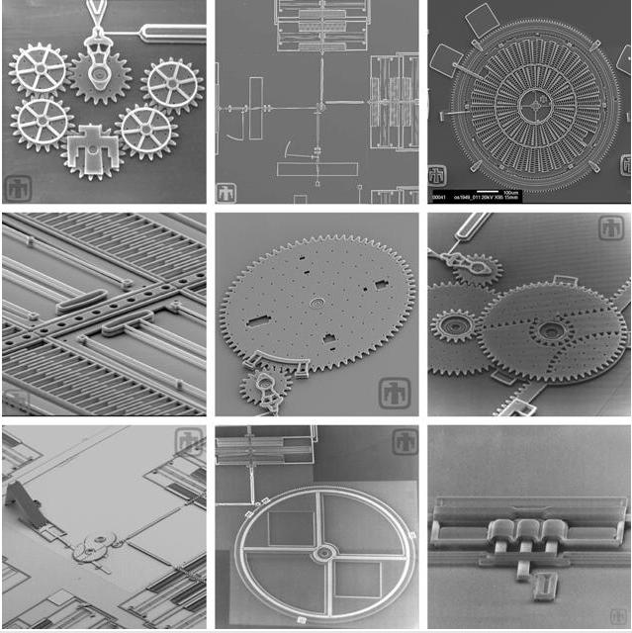
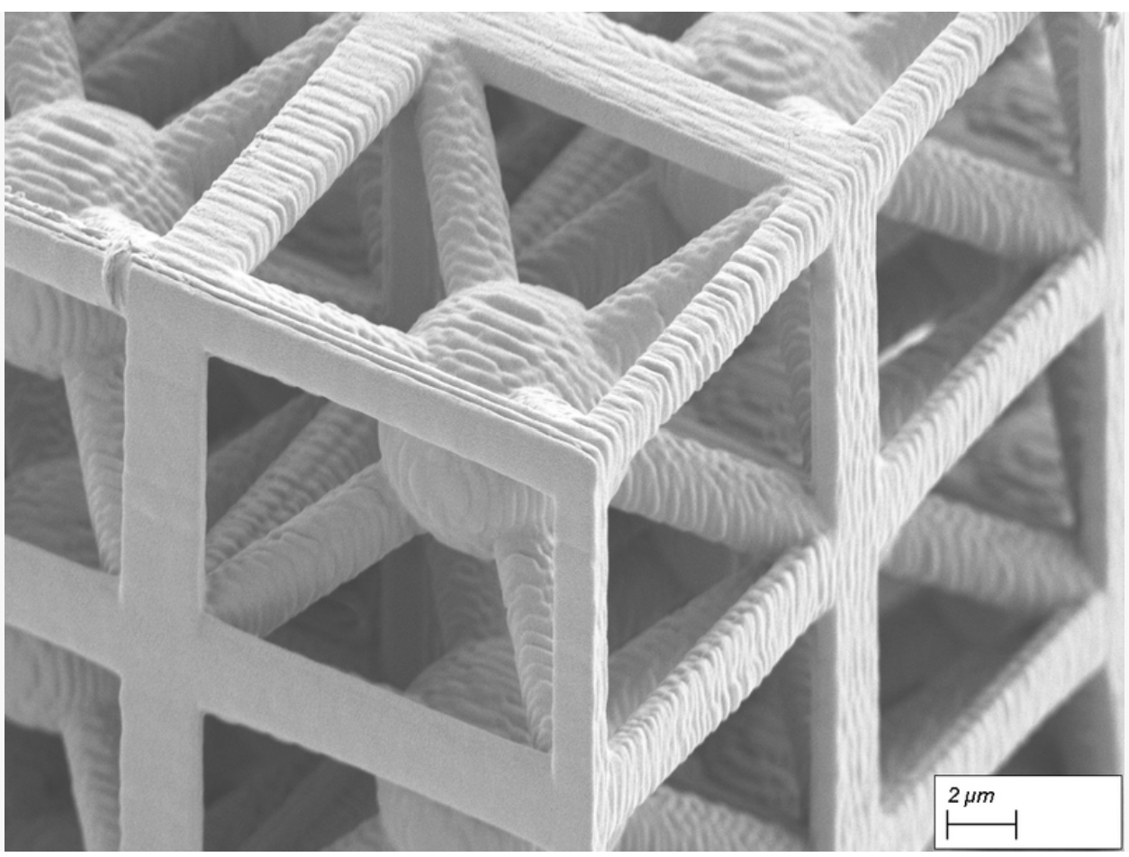
Motivations
Sun et al, 2024, Science Advances
Braced cubic lattice

Slide 4
Motivations
The internal structure cannot be neglected.
1)What is fracture?
2)Can we apply conventional concepts based on continuum mechanics to such discrete structures?
3)Is there a limit?
J-integral

Slide 5
Methods

Slide 6
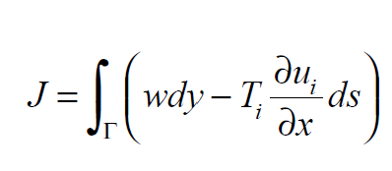
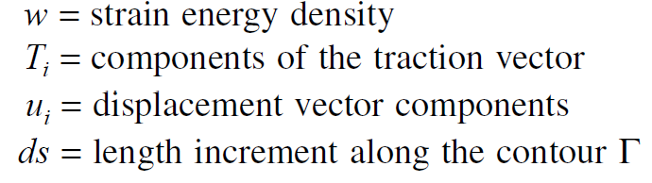
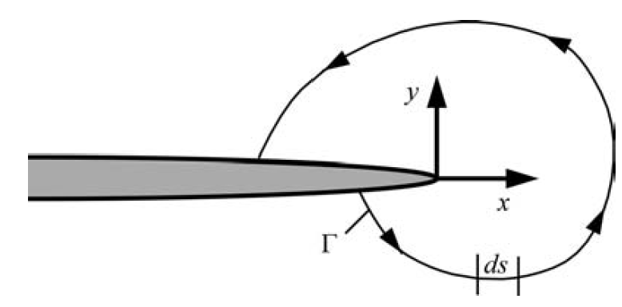
Methods
J-integral
  1968 by Rice
  Path independent contour integral for characterizing cracks in linear and non-linear materials

Slide 7
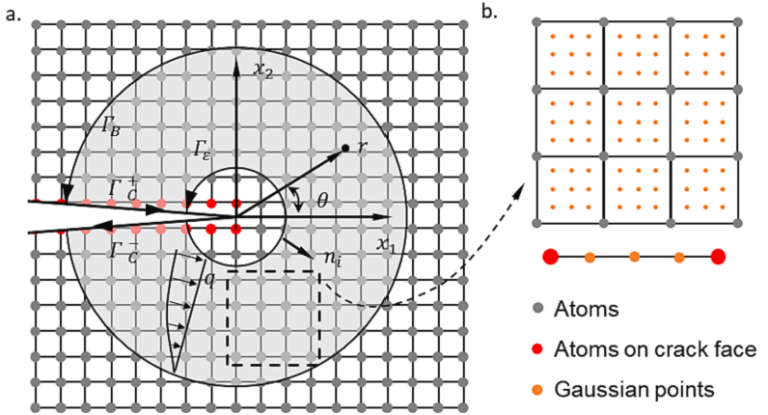
Methods
J-integral at small scale
  Atom-by-atom evaluation
  Equivalent domain integral approaches
  Complex integral schemes
Challenges
  Path independence?
  Atomic quantities such as stresses, strain, displacement etc…
Jia et al, 2022, TAFM

Slide 8
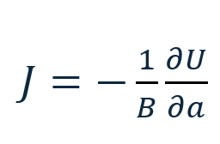
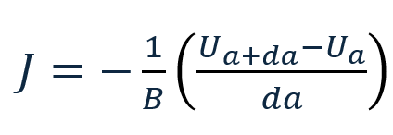
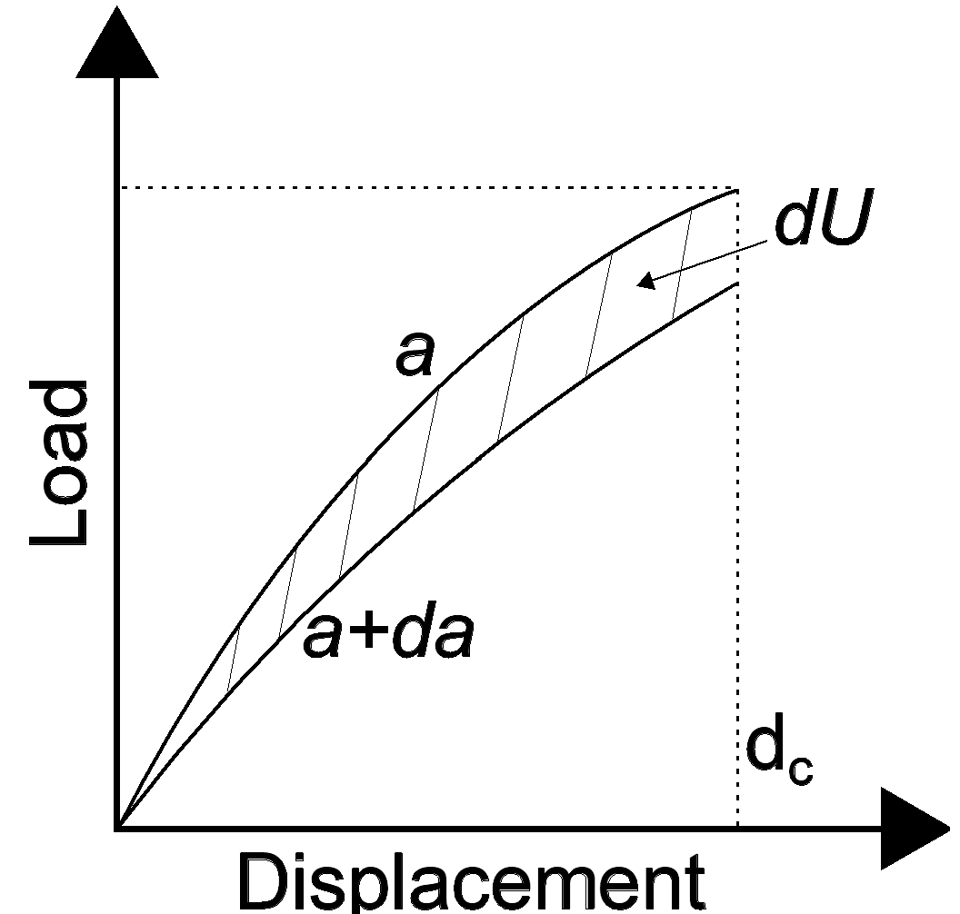
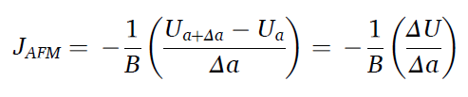
Methods
J-integral at small scale: finite J-integral
J is the difference in energy absorbed by specimens with neighbouring crack sizes for elastic-plastic materials. Therefore, it can be expressed as a difference in potential energy.
B: plate thickness
a: crack length
Δa: increment in crack length
Gallo et al., TAFM145 (2026) 105627 https://doi.org/10.1016/j.tafmec.2026.105627

Slide 9
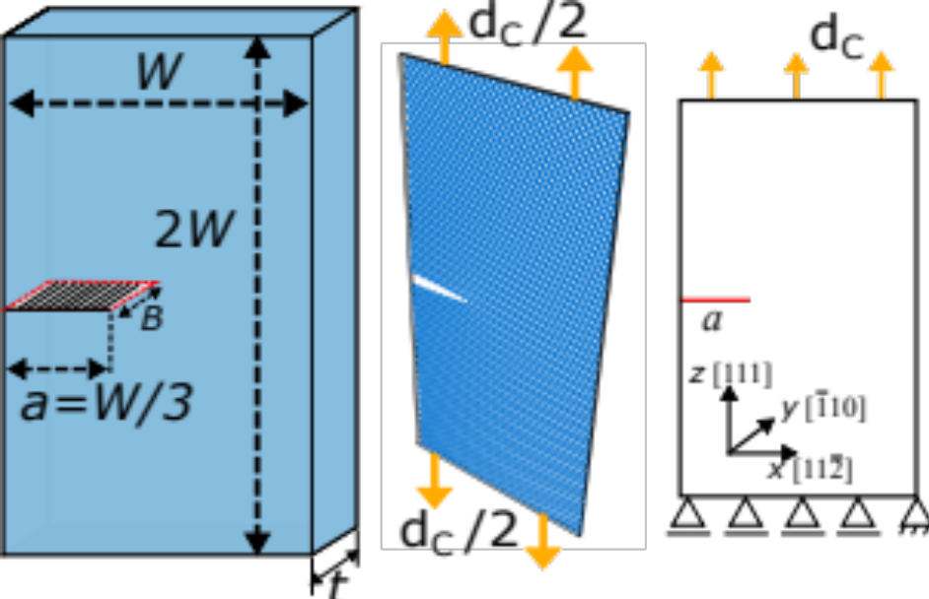
Methods
J-integral at small scale
LAMMPS and FEA
Single-crystal silicon
W: varied from 200 nm to 10 nm
Anisotropic
Δa: 1 atomic bond
Analysis for crack length a and Δa at the same critical displacement
Δa corresponds to the minimum physical crack advance (~0.33 nm)
Gallo et al., TAFM145 (2026) 105627 https://doi.org/10.1016/j.tafmec.2026.105627

Slide 10
Results and Discussion

Slide 11
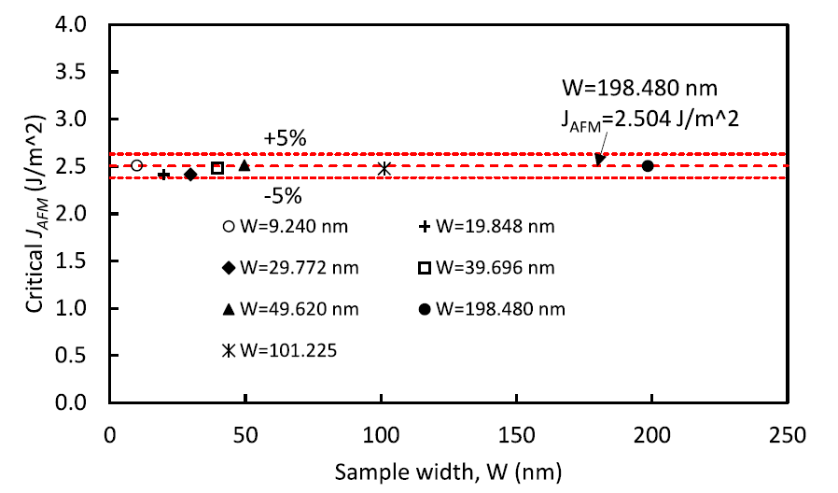
Results and Discussion
Gallo et al., TAFM145 (2026) 105627 https://doi.org/10.1016/j.tafmec.2026.105627

Slide 12
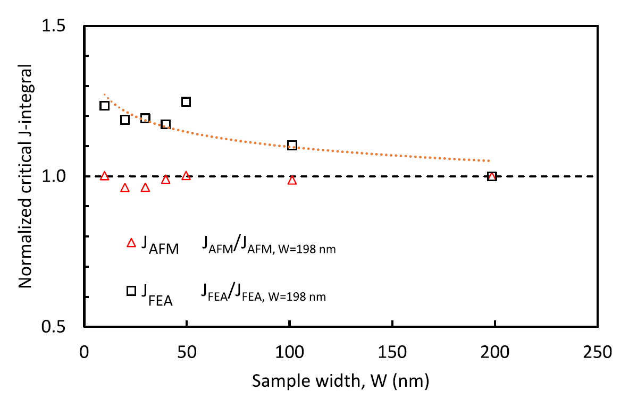
Results and Discussion
Gallo et al., TAFM145 (2026) 105627 https://doi.org/10.1016/j.tafmec.2026.105627

Slide 13
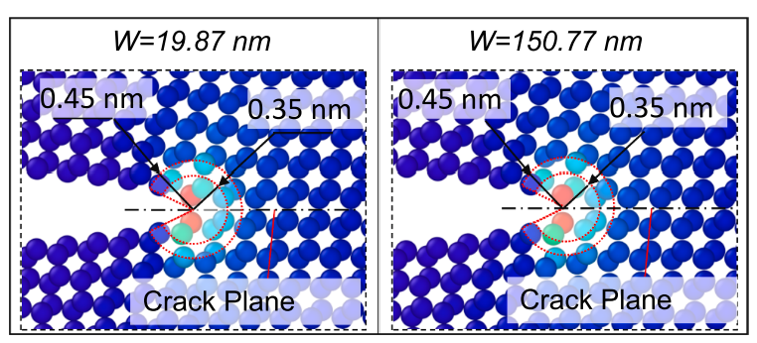
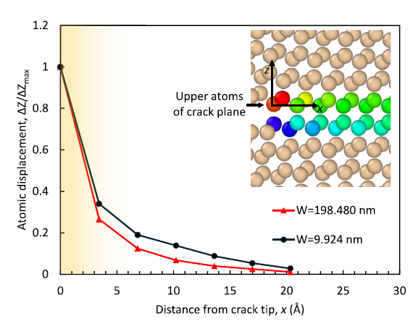
Results and Discussion
Griffith-type energetic arguments
Gc = 2γ = 2.0–2.6 J/m²
Surface energy γ = 1.0–1.3 J/m² for Si(111)
Why is continuum failing?
Fracture process zone Λ_{f}
W width >> Λ_{f} clear separation scale
W/ Λ_{f} on the order of 10²
Gallo et al., TAFM145 (2026) 105627 https://doi.org/10.1016/j.tafmec.2026.105627

Slide 14
Conclusions
J_{AFM} remains nearly constant (~2.5 J/m²) across specimen sizes, confirming scale independence and atomistic bond-breaking control.
Δa corresponds to the minimum physical crack advance (~0.33 nm), directly linking the formulation to a single bond-breaking event.
The fracture process zone remains constant (Λf ≈ 0.5 nm), confirming a highly localized, geometry-independent fracture mechanism.
Nanoscale deviations arise from the loss of scale separation between the fracture process zone and specimen dimensions.
The finite-difference approach is simple, physically transparent, and computationally efficient, while retaining a direct link to atomic bond breaking.
Gallo et al., TAFM145 (2026) 105627 https://doi.org/10.1016/j.tafmec.2026.105627

Slide 15
A finite atomistic J-integral and the limits of continuum fracture mechanics
Pasquale Gallo
Gallo et al., TAFM145 (2026) 105627 https://doi.org/10.1016/j.tafmec.2026.105627

