Slide 1
Effect of Stator Cooling Channel Position on Thermal Performance of Oil-Cooled Motor
Chengyang Ye, Andrea Tonoli*, Enrico Cesare Zenerino
Politecnico di Torino

Slide 2
Motivations and objectives
Motivation
Cooling is a key issue in electric traction motors to improve the power density and efficiency
Main cooling types are:
Water jacket
Direct cooling by means of
-Spray cooling of end windings
-Liquid cooling of end windings
-Liquid cooling of end windings and slots (most efficient)
Considering slot liquid cooling, the best position of the cooling channel is not investigated yet especially in case of hairpin windings with high filling factors.
Objective
Investigate the cooling performance of different radial positions of the cooling channel in stator cooling systems with hairpin windings.

Slide 3
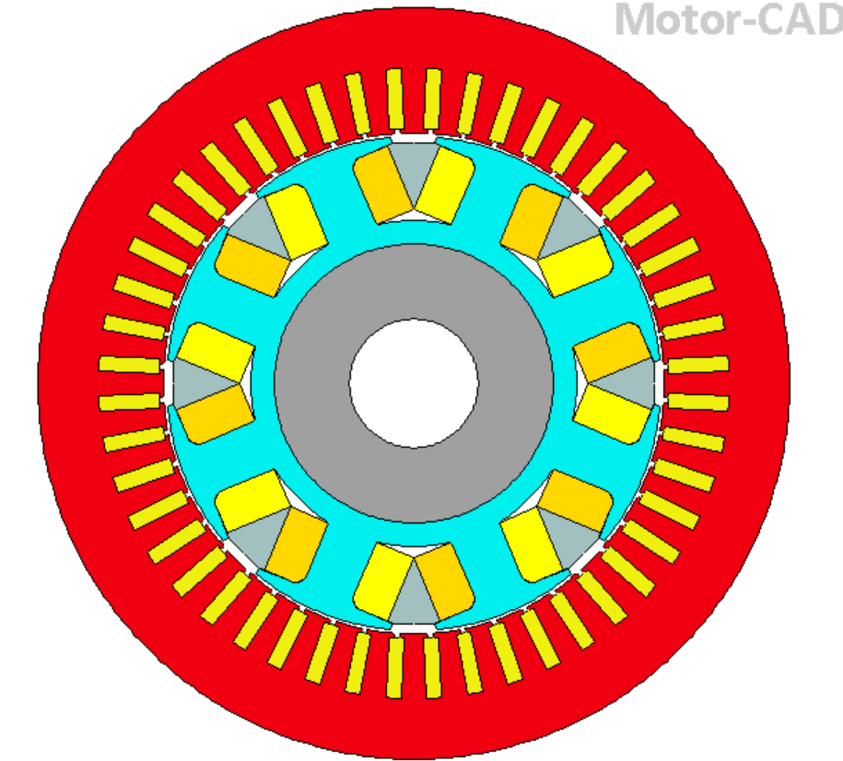
Study case: EESM motor
Application:
Electrically excited synchronous motor for automotive traction.
Main characteristics:
Stator Outer Diameter: 175.14 mm
Stator inner Diameter: 116.62 mm
Motor length: 105 mm
Slot number : 48
Oil flow rate: 10 L/min
The winding is a hairpin.
Peak power: 36 kW
Peak torque: 80 Nm

Slide 4
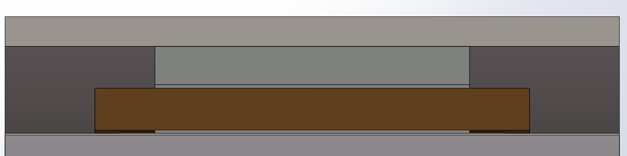
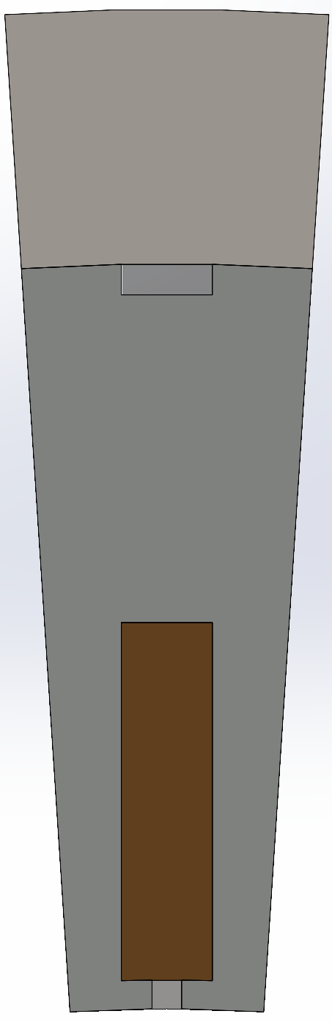
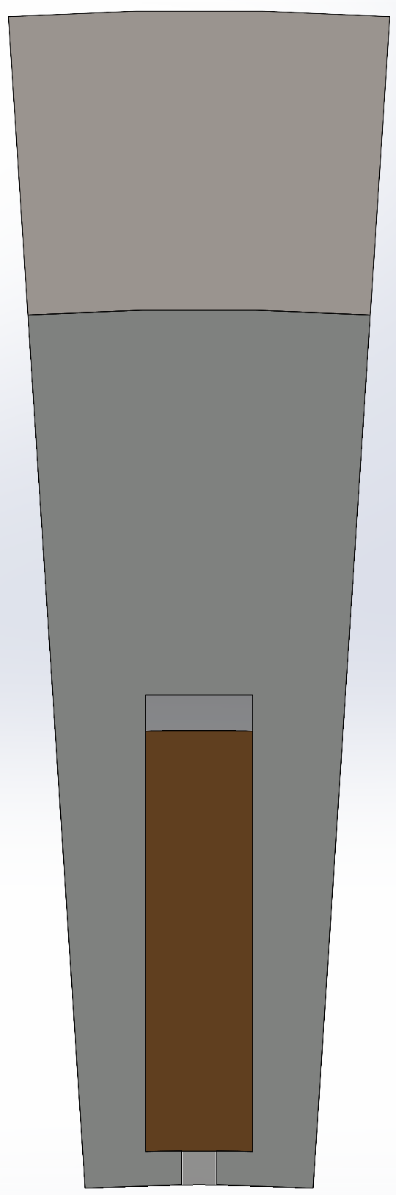
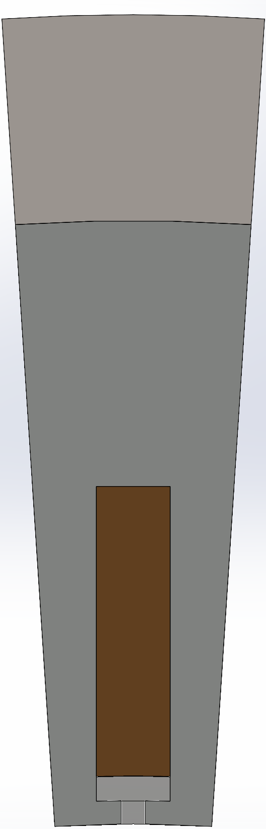
Stator cooling strategies
Slot
Outlet
Inlet
lamination slot cooling (reference)
winding outer slot cooling
winding inner slot cooling
Cooling channel
a)
b)
c)

Slide 5
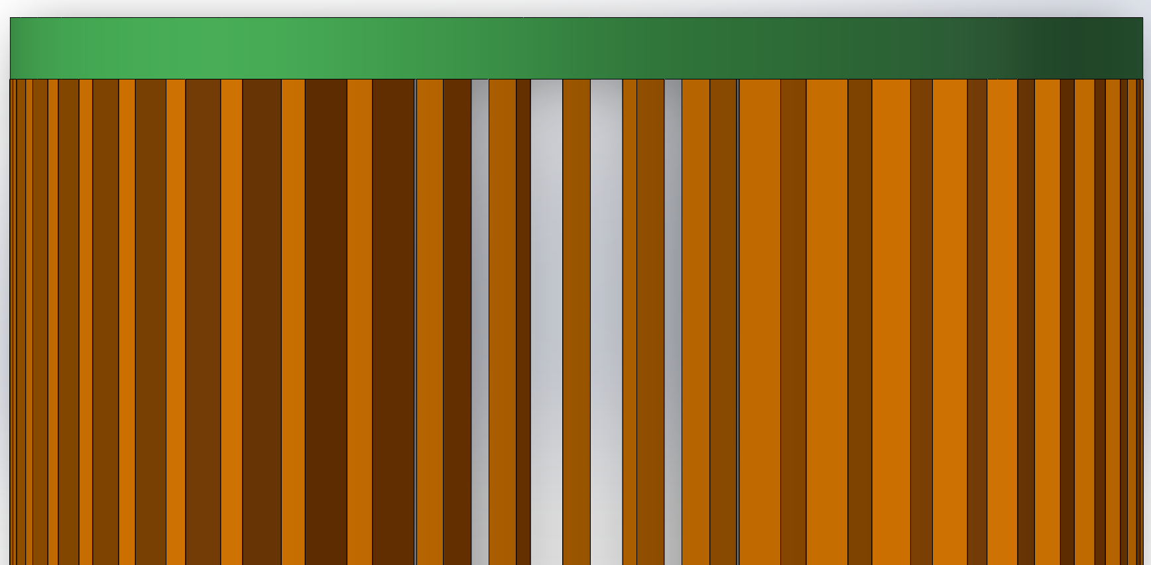
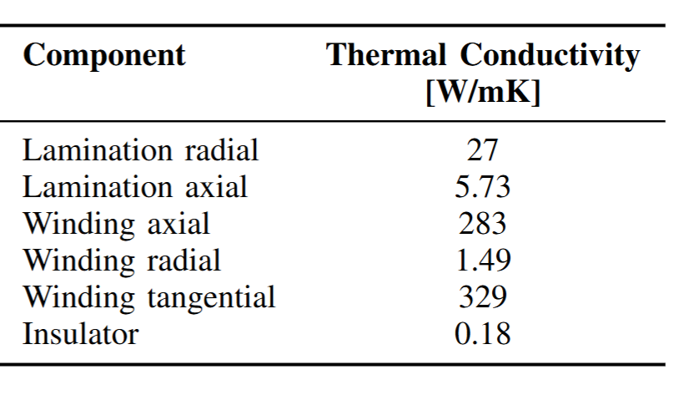
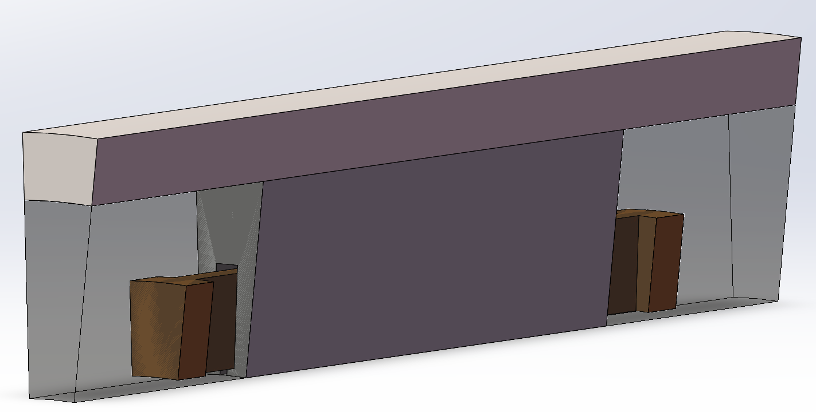
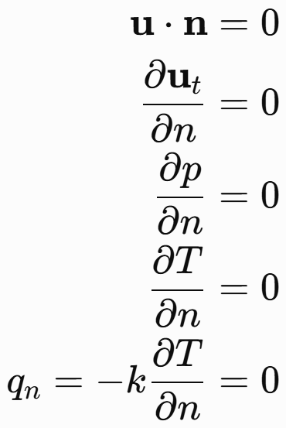
winding coordinate and boundary condition
end winding
y
z
x
slot winding
x
z
y
Only one slot is included in the CFD model
The interface between each area is considered as a symmetric boundary condition
Losses are considered as a homogeneous heat source

Slide 6


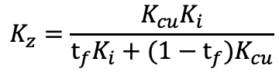





Equivalent winding
$$\frac{t_{i}}{2}$$
Z-direction:
Copper and insulation in series
Equivalent conductivity based on relative thickness
→ Inverse rule of mixtures
a)
$$K_{z}=\frac{K_{cu}K_{i}}{t_{f}K_{i}+(1−t_{f})K_{cu}}$$
$$t_{f}=\frac{t_{Cu}}{t_{i}+t_{Cu}}$$
y-direction:
Copper and insulation first in parallel
Equivalent conductivity based on relative thickness
→ Rule of mixtures
Side insulation → additional thermal resistance
$$t_{Cu}$$
b)
Equivalent winding
y
$K_{y}=t_{f}$ $K_{cu}+(1−t_{f})K_{i}$
x
z
x-direction:
Copper and insulation in parallel
Equivalent conductivity based on filling factor
→ Rule of mixtures
$$F_{f}=\frac{A_{Cu}}{A_{i}+A_{Cu}}$$
Side insulation modeled as thermal resistance
$K_{x}=F_{f}$ $K_{cu}+(1−F_{f})K_{i}$

Slide 7
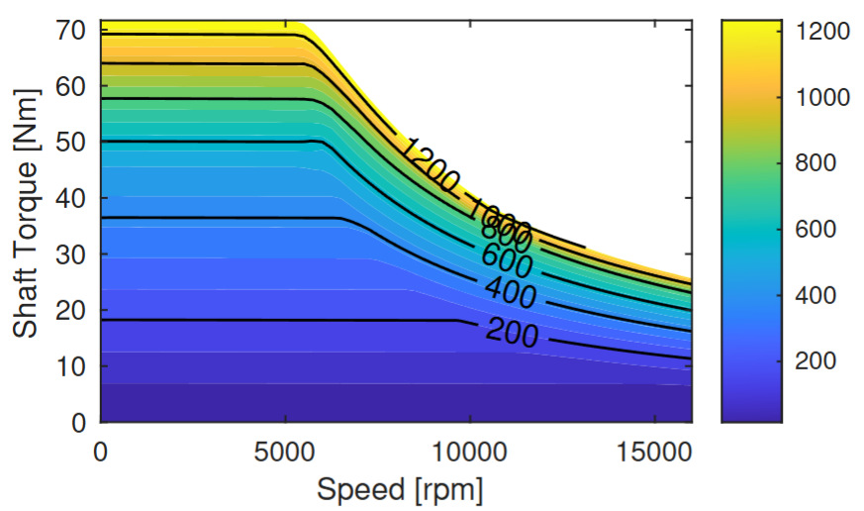
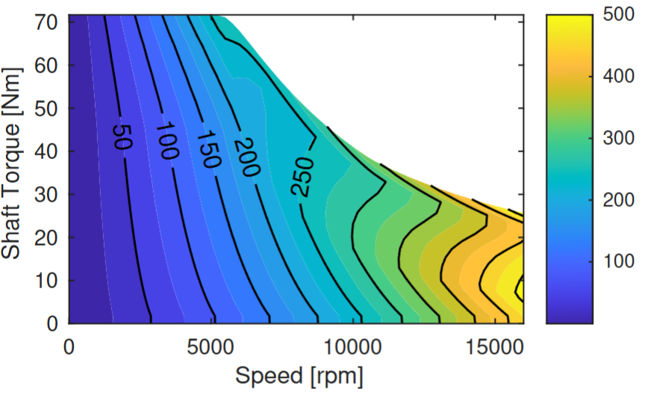

Loss model and working point
The loss is considered as temperature depended
$${P_{Cu}=P}_{Cu,ref}∗(1+α\left(T−T_{ref}\right))$$
Copper loss
Iron loss
Working point :
5000 rpm
35 Nm
Copper loss : 1390
Flow rate: 10L/min
Iron loss: 292

Slide 8
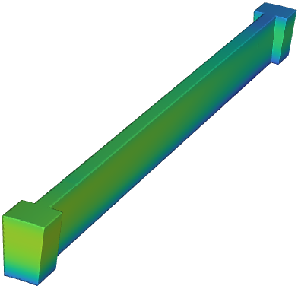
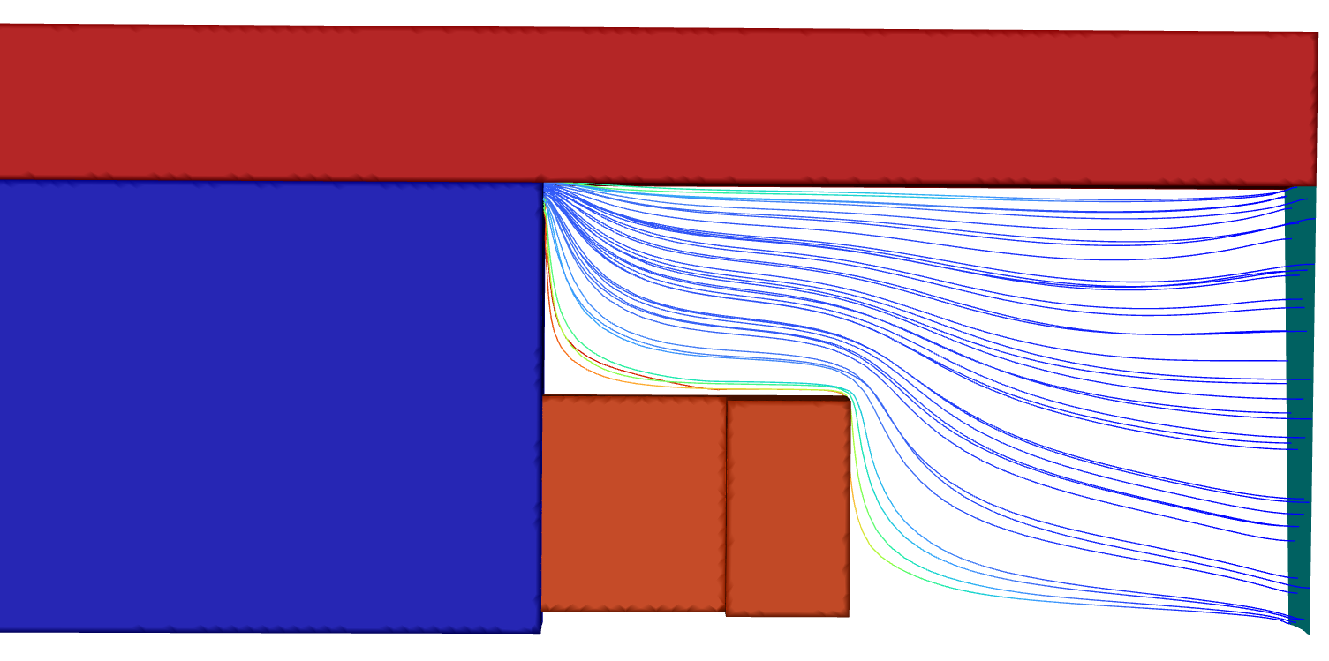
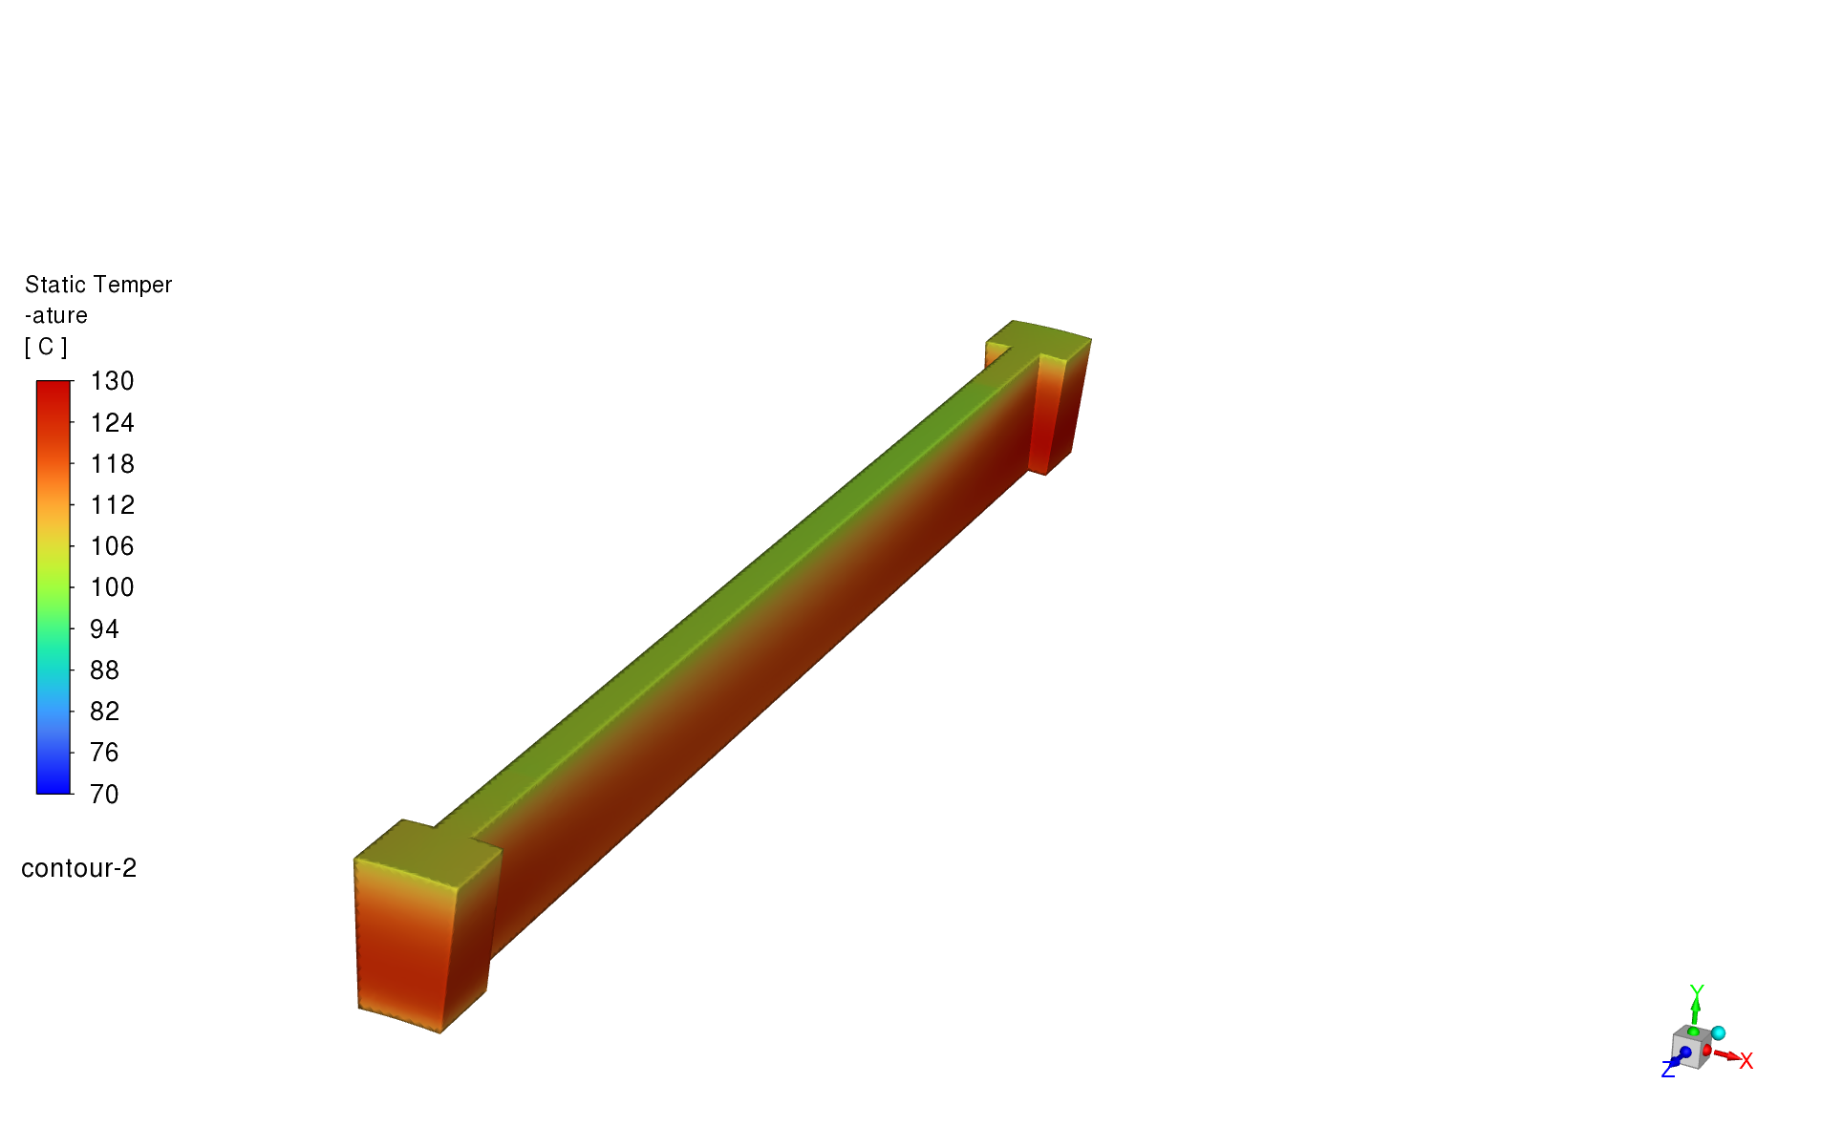
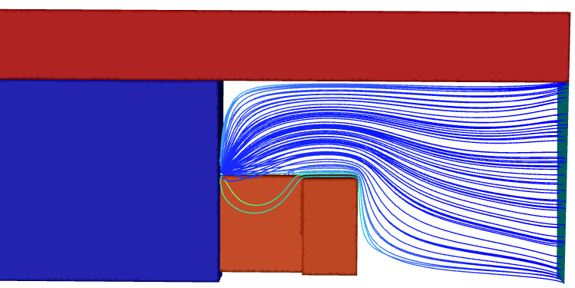
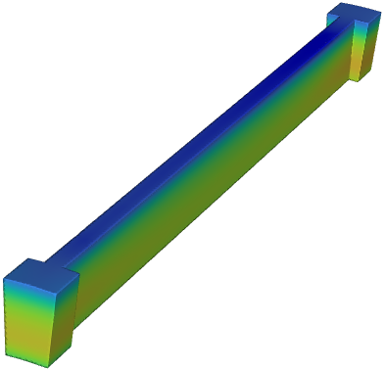
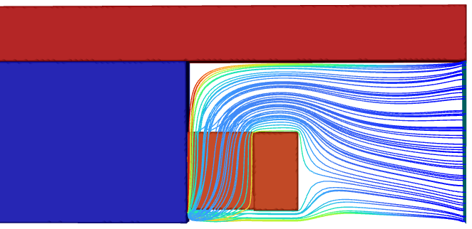
Results
Stream line
Winding temperature
a)
c)
Better cooling on end winding
b)
a)
b)
c)

Slide 9
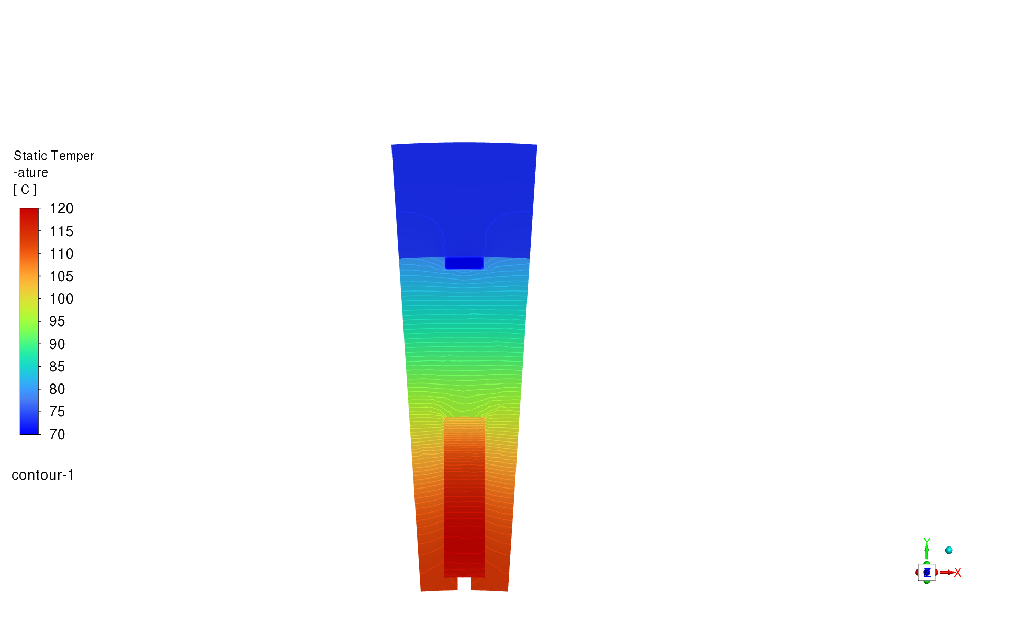
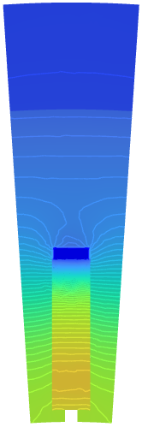
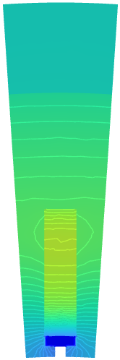
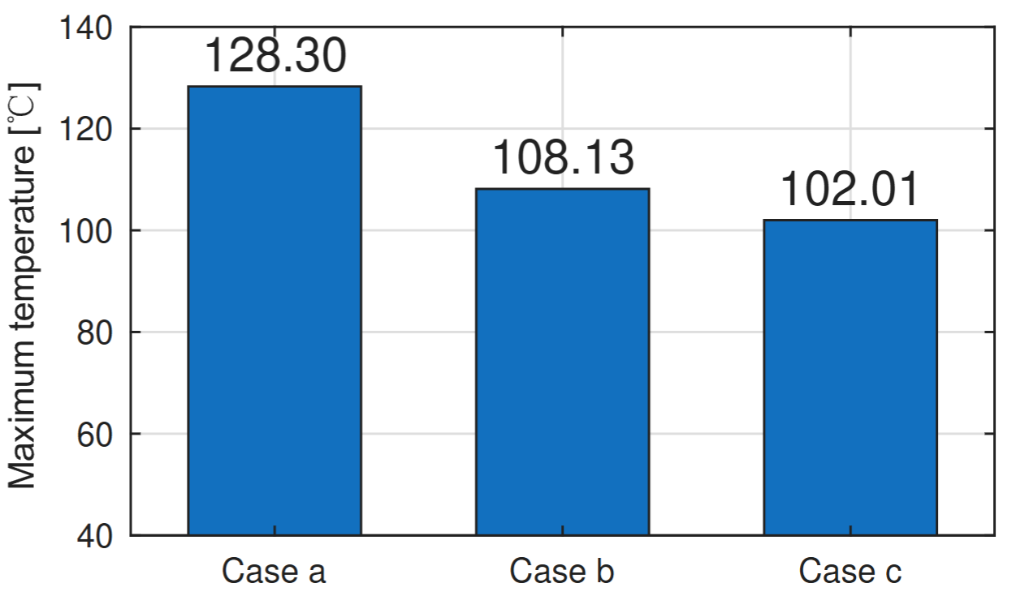
Results: temperatures in cross section
Temperature in the middle cross-section
Temperature [℃]
a)
b)
c)

Slide 10
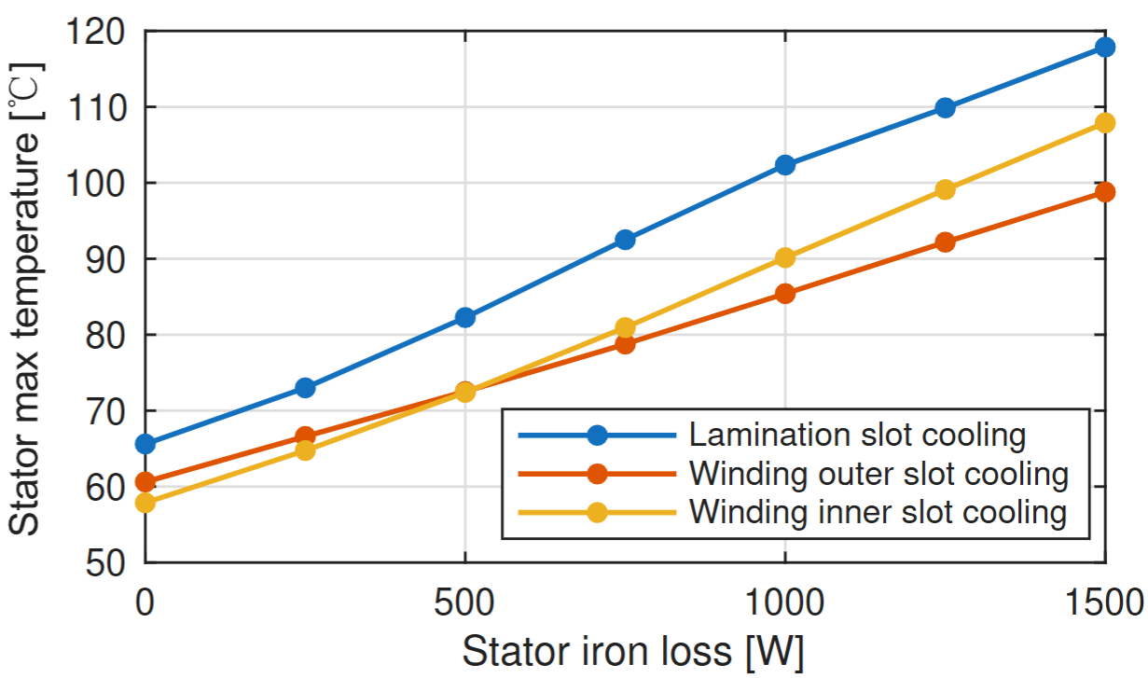
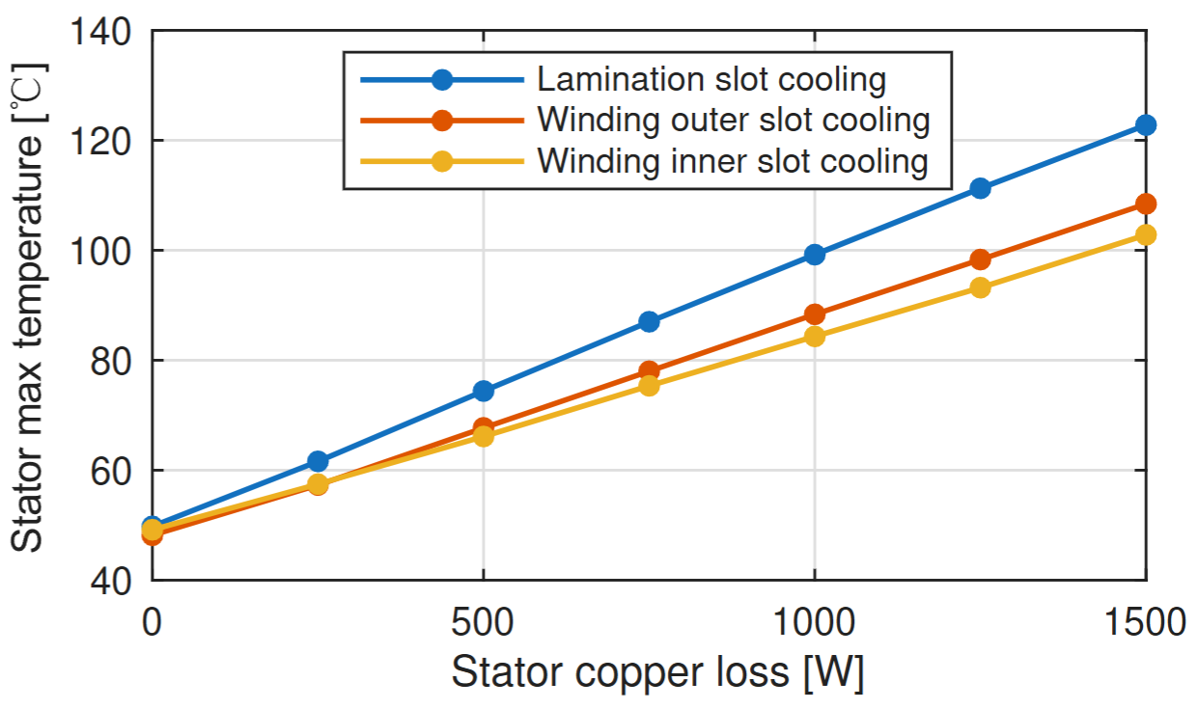
Sensitivity analysis
breakeven
copper loss equal to 500 W
iron loss equal to 300 W
Inner slot cooling leads to higher temperatures with increasing iron losses.
Outer slot cooling leads to higher temperatures with increasing copper loss
The advantage between the winding inner/outer cooling is decided by the ratio of copper and iron loss

Slide 11
Conclusions
The winding can be modeled as an equivalent entity to reduce computational cost.
The radial cooling channel configurations show the following characteristics:
Lamination-slot cooling:
+ Easy to manufacture
- Relatively limited cooling performance
Winding outer-slot cooling
+ Better cooling of iron losses
- Less effective cooling of copper losses.
Winding inner-slot cooling
+ Better cooling of copper losses
- Less effective cooling of iron losses.

Slide 12
Thank you
Andrea.tonoli@polito.it

